Slide 1
Design and Analysis of Algorithms
Design and Analysis of Algorithms
Lecture-1
Dharmendra Kumar(Associate Professor(UCER))

Slide 2
Definition of Algorithm
An algorithm is any well-defined computational procedure that takes some value, or set of values, as input and produces some value, or set of values, as output.
An algorithm is thus a sequence of computational steps that transform the input into the output.
An algorithm is a set of steps to accomplish or complete a task that is described precisely enough
that a computer can run it.

Slide 3
Characteristics of an algorithm
Input: Algorithm must contain 0 or more input values.
Output: Algorithm must contain 1 or more input values.
Finiteness: Algorithm must complete after finite number of steps.
Definiteness: Each instruction of the algorithm must be defined precisely or clearly.
Effectiveness: Every instruction must be basic i.e. simple instruction.

Slide 4
Design Strategy of Algorithm
Divide and Conquer
Dynamic Programming
Branch and Bound
Greedy Approach
Backtracking
Randomized Algorithm

Slide 5
Analysis of algorithms
Analysis of algorithms is the determination of the amount of time and space resources required to execute it.
Time complexity: The amount of time required by an algorithm is called time complexity.
Space complexity: The amount of space/memory required by an algorithm is called space complexity.

Slide 6
Analysis of algorithms
The main concern of analysis of algorithms is the required time or performance. Generally, we perform the following types of analysis −
Worst case − The maximum number of steps taken on any instance of size n.
Best case − The minimum number of steps taken on any instance of size n.
Average case − An average number of steps taken on any instance of size n.

Slide 7
Running time of an algorithm
Running time of an algorithm is the time taken by the algorithm to execute it successfully.
The running time of an algorithm on a particular input is the number of primitive operations or "steps" executed.
It is convenient to define the notion of step so that it is as machine independent as possible.
It is denoted by T(n), where n is the input size.

Slide 8
Pseudo code conventions
We use the following conventions in our pseudo code.
Indentation is used to indicate a block.
The looping constructs while, for, and repeat-until and the if-else conditional construct have interpretations similar to those in C.
The symbol “//” indicates that the remainder of the line is a comment.
A multiple assignment of the form i←j ← e assigns to both variables i and j the value of expression e; it should be treated as equivalent to the assignment j ← e followed by the assignment i ← j .

Slide 9
Pseudo code conventions
We access array elements by specifying the array name followed by the index in square brackets. For example, A[i] indicates the i^{th} element of the array A.
The notation “..” is used to indicate a range of values within an array. Thus, A[1..j] indicates the sub-array of A consisting of the j elements A[1], A[2],…………,A[j].
The Boolean operators “and” and “or” are used.
A return statement immediately transfers control back to the point of call in the calling procedure.

Slide 10
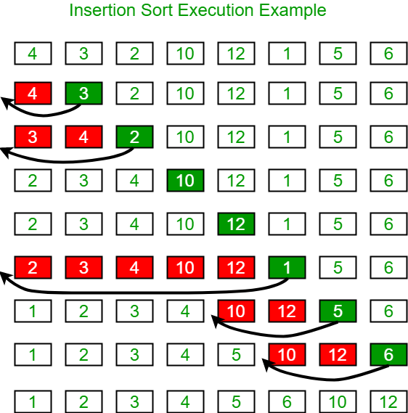
Insertion Sort
Ex. Sort the following elements by insertion sort:- 4, 3, 2, 10, 12, 1, 5, 6.

Slide 11
Insertion Sort Algorithm
Insertion_Sort(A)
n← length[A]
for j←2 to n
    a←A[j]
    //Insert A[j] into the sorted sequence A[1 .. j-1].
    i← j-1
    While i > 0 and a < A[i]
        A[i+1]←A[i]
        i← i-1
    A[i+1] ← a

Slide 12
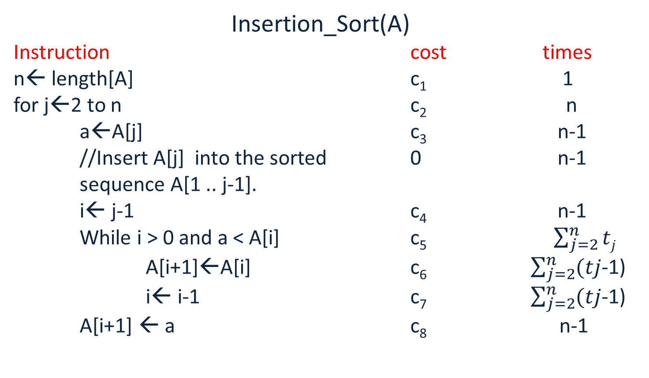
Insertion Sort Algorithm Analysis
Insertion_Sort(A)
Instruction cost times
n← length[A] c₁ 1
for j←2 to n c₂ n
    a←A[j] c₃ n-1
    //Insert A[j] into the sorted 0 n-1
    sequence A[1 .. j-1].
    i← j-1 c₄ n-1
    While i > 0 and a < A[i] c₅ $\sum_{j=2}^{n}{tj}$
        A[i+1]←A[i] c₆ $\sum_{j=2}^{n}{(tj}$-1)
        i← i-1 c₇ $\sum_{j=2}^{n}{(tj}$-1)
    A[i+1] ← a c₈ n-1

Slide 13
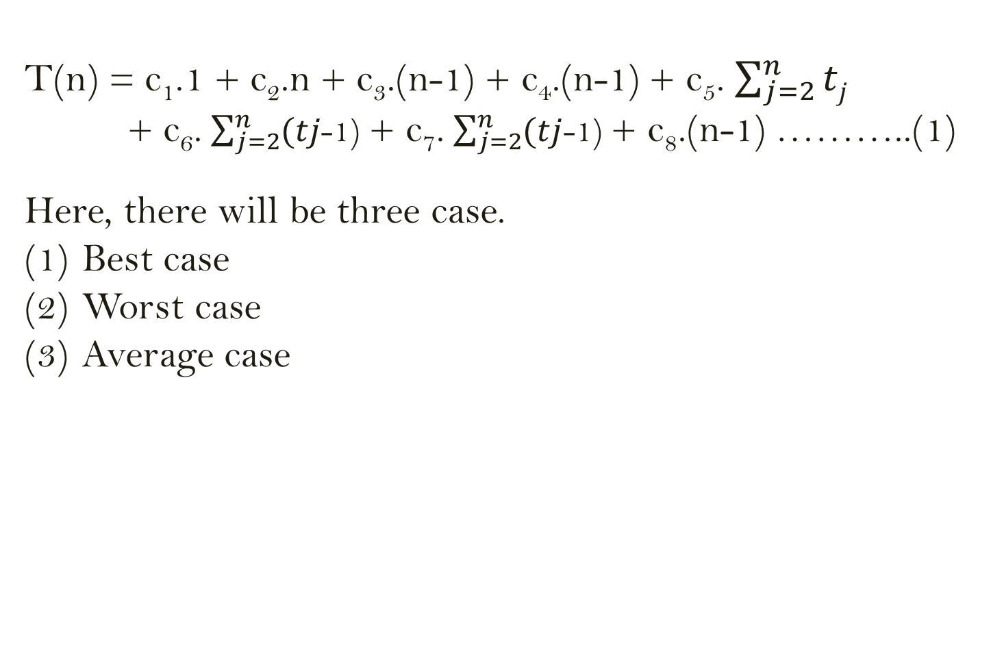
Time complexity of Insertion sort
        T(n) = c₁.1 + c₂.n + c₃.(n-1) + c₄.(n-1) + c₅. $\sum_{j=2}^{n}{tj}$
        + c₆. $\sum_{j=2}^{n}{(tj}$-1) + c₇. $\sum_{j=2}^{n}{(tj}$-1) + c₈.(n-1) ………..(1)
        Here, there will be three case.
        Best case
        Worst case
        Average case

Slide 14
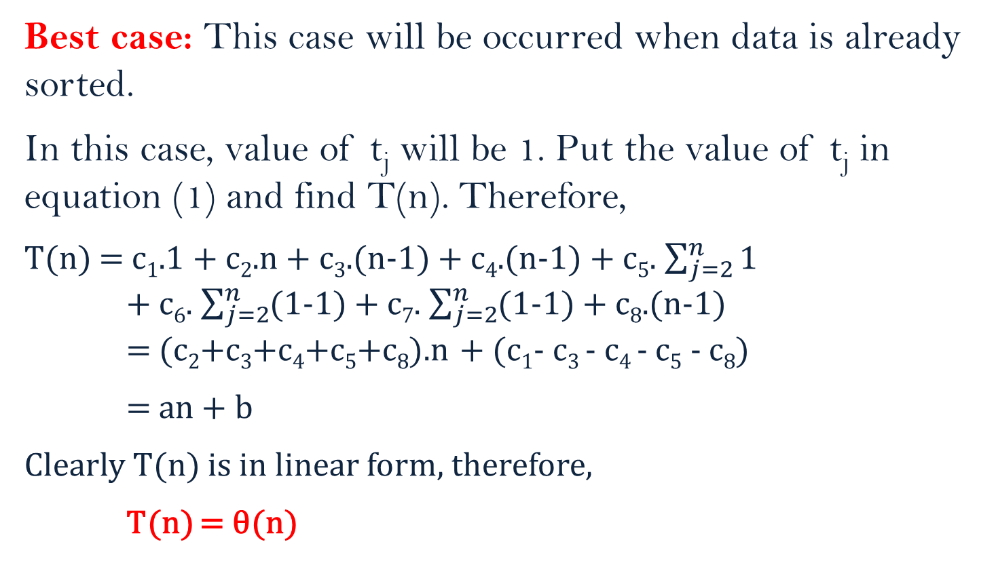
Time complexity of Insertion sort
Best case: This case will be occurred when data is already sorted.
In this case, value of t_{j} will be 1. Put the value of t_{j} in equation (1) and find T(n). Therefore,
        T(n) = c₁.1 + c₂.n + c₃.(n-1) + c₄.(n-1) + c₅. $\sum_{j=2}^{n}{1}$
        + c₆. $\sum_{j=2}^{n}{(1}$-1) + c₇. $\sum_{j=2}^{n}{(1}$-1) + c₈.(n-1)
= (c₂+c₃+c₄+c₅+c₈).n + (c₁- c₃ - c₄ - c₅ - c₈)
= an + b
Clearly T(n) is in linear form, therefore,
T(n) = θ(n)

Slide 15
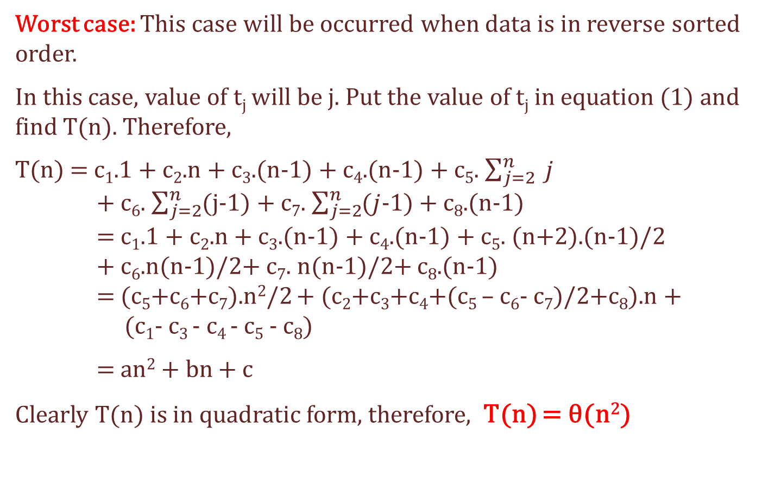
Time complexity of Insertion sort
Worst case: This case will be occurred when data is in reverse sorted order.
In this case, value of t_{j} will be j. Put the value of t_{j} in equation (1) and find T(n). Therefore,
        T(n) = c₁.1 + c₂.n + c₃.(n-1) + c₄.(n-1) + c₅. $\sum_{j=2}^{n}{ j}$
        + c₆. $\sum_{j=2}^{n}{(j}$-1) + c₇. $\sum_{j=2}^{n}{(j}$-1) + c₈.(n-1)
        = c₁.1 + c₂.n + c₃.(n-1) + c₄.(n-1) + c₅. (n+2).(n-1)/2
        + c₆.n(n-1)/2+ c₇. n(n-1)/2+ c₈.(n-1)
= (c₅+c₆+c₇).n²/2 + (c₂+c₃+c₄+(c₅ – c₆- c₇)/2+c₈).n + (c₁- c₃ - c₄ - c₅ - c₈)
= an² + bn + c
Clearly T(n) is in quadratic form, therefore, T(n) = θ(n²)

Slide 16
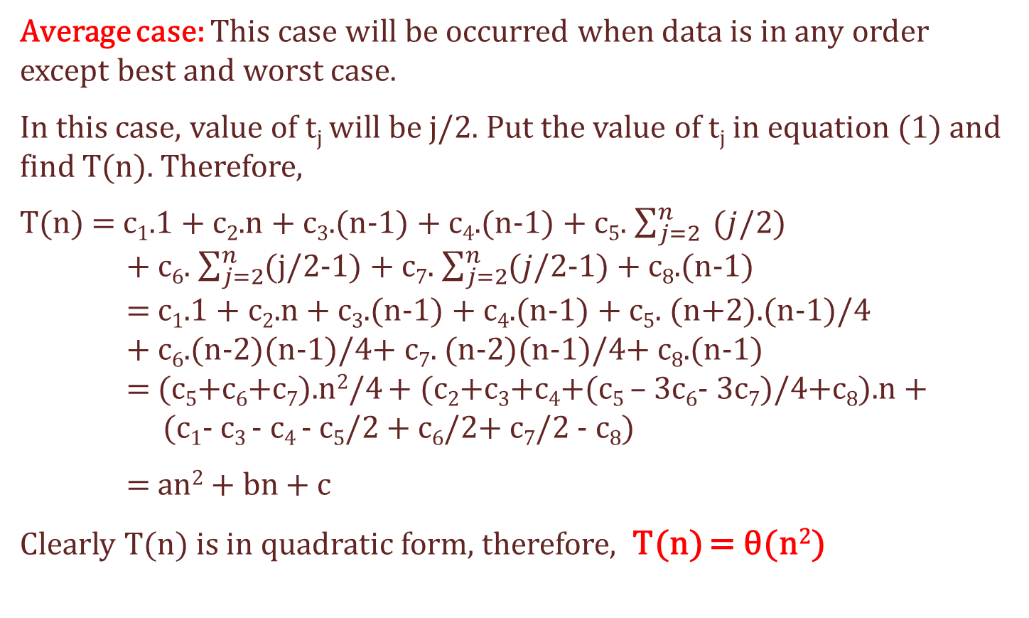
Time complexity of Insertion sort
Average case: This case will be occurred when data is in any order except best and worst case.
In this case, value of t_{j} will be j/2. Put the value of t_{j} in equation (1) and find T(n). Therefore,
        T(n) = c₁.1 + c₂.n + c₃.(n-1) + c₄.(n-1) + c₅. $\sum_{j=2}^{n}{ (j}$/2)
        + c₆. $\sum_{j=2}^{n}{(j/2}$-1) + c₇. $\sum_{j=2}^{n}{(j}$/2-1) + c₈.(n-1)
        = c₁.1 + c₂.n + c₃.(n-1) + c₄.(n-1) + c₅. (n+2).(n-1)/4
        + c₆.(n-2)(n-1)/4+ c₇. (n-2)(n-1)/4+ c₈.(n-1)
= (c₅+c₆+c₇).n²/4 + (c₂+c₃+c₄+(c₅ – 3c₆- 3c₇)/4+c₈).n + (c₁- c₃ - c₄ - c₅/2 + c₆/2+ c₇/2 - c₈)
= an² + bn + c
Clearly T(n) is in quadratic form, therefore, T(n) = θ(n²)

Slide 17
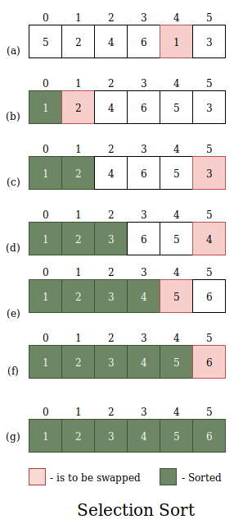
Selection Sort

Slide 18
Selection Sort Algorithm
Selection_sort(A)
        n ←length[A]
        for i←1 to n-1
    min ← i
    for j←i+1 to n
        if(A[j] < A[min])
            min ←j
        Interchange A[i] ↔ A[min]
Time complexity, T(n) = θ (n²)

Slide 19
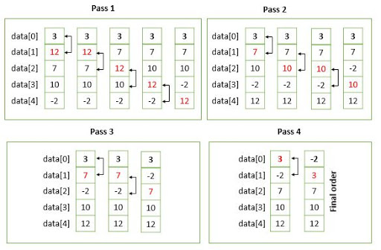
Bubble Sort

Slide 20
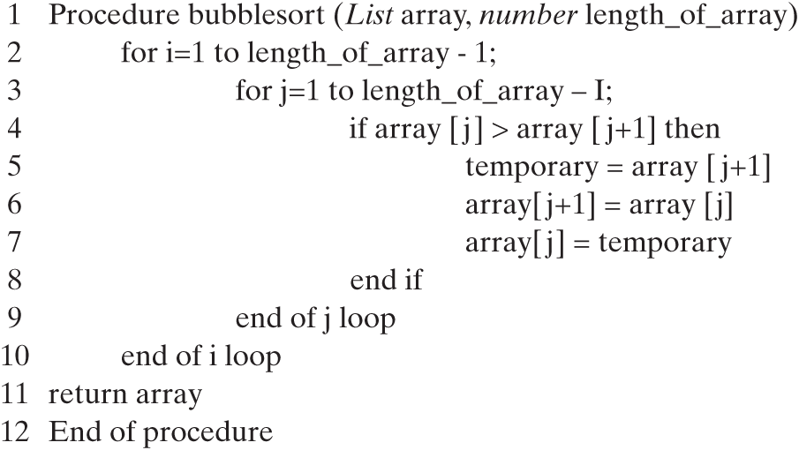
Bubble Sort Algorithm
Bubble _Sort(A)

Slide 21
Divide and Conquer approach
problem.
The divide-and-conquer paradigm involves three steps at each level of the recursion:
Divide the problem into a number of sub-problems that are smaller instances of the same problem.
Conquer the sub-problems by solving them recursively. If the sub-problem sizes are small enough, however, just solve the sub problems in a straightforward manner.
Combine the solutions to the sub-problems into the solution for the original problem.

Slide 22
Analysis of Divide and Conquer based algorithm
problem.
When an algorithm contains a recursive call to itself, we can often describe its running time by a recurrence equation or recurrence, which describes the overall running time on a problem of size n in terms of the running time on smaller inputs. We can then use mathematical tools to solve the recurrence and provide bounds on the performance of the algorithm.

Slide 23
Analysis of Divide and Conquer based algorithm
problem.
A recurrence equation for the running time of a divide-and-conquer algorithm uses the three steps of the basic paradigm.
The recurrence equation for the running time of a divide-and-conquer algorithm is the following:-
T(n) = aT(n/b) + D(n) + C(n), if n > c
= θ(1) , otherwise
Where, n is the size of original problem. a is the number of sub-problems in which the original problem divided at an instant. Each sub-problems has size n/b. c is a small integer.

Slide 24
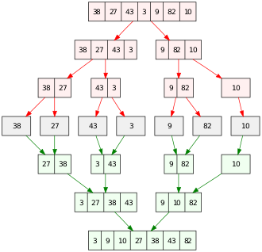
Merge Sort

Slide 25
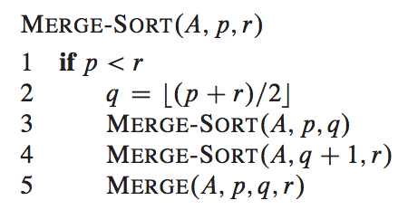
Merge Sort Algorithm

Slide 26
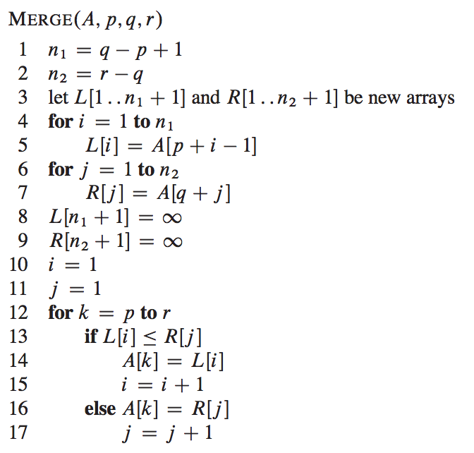
Merge Sort Algorithm

Slide 27
Merge Sort Algorithm Analysis
The recurrence equation for the running time of merge sort algorithm will be
T(n) = 2T(n/2) + θ(1)+ θ(n), if n > 1
= θ(1) , otherwise
It can be modified as:-
T(n) = 2T(n/2) + θ(n) , if n > 1
= θ(1) , otherwise

Slide 28
Merge Sort Algorithm Analysis
When we solve recurrence equation, modify it as:-
T(n) = 2T(n/2) + cn , if n > 1
= d , otherwise
Here, c and d are some constants.

Slide 29
Merge Sort Algorithm Analysis
Iterative method:
T(n) = 2T(n/2) + cn
= 2(2T(n/4) + cn/2) + cn
= 2²T(n/4) + 2cn
= 2²(2T(n/8)+cn/4) + 2cn
= 2³T(n/8)+ 3cn
= ………………….
= 2^{k}T(n/2^{k}) + kcn
= nT(1) + c nlog(n) (Let n = 2^{k} )
= dn + cnlog(n) (since T(1) = d)
= θ(nlog(n))
Therefore, T(n) = θ(nlog(n))

Slide 30
Asymptotic Notations
The notations we use to describe the asymptotic running time of an algorithm are defined in terms of functions whose domains are the set of natural numbers N={ 0, 1, 2, …………}.
We will use asymptotic notations to describe the running times of algorithms.
Following notations are used to define the running time of algorithms.
    Θ−notation
    O-notation
    Ω-notation
    o-notation
    ω-notation

Slide 31
Asymptotic Notations
Θ−notation ( Theta notation )
For a given function g(n), it is denoted by Θ(g(n)).
It is defined as following:-
Θ(g(n)) = { f(n) ! ∃positive constants c₁, c₂ and n₀ such that
0 ≤ c₁g(n) ≤ f(n) ≤ c₂g(n), ∀ n ≥ n₀ }
This notation is said
to be tight bound.
If f(n) ∈ Θ(g(n)) then
f(n) = Θ(g(n))

Slide 32
Asymptotic Notations
Ο−notation ( Big-oh notation )
For a given function g(n), it is denoted by Ο(g(n)).
It is defined as following:-
Ο(g(n)) = { f(n) ! ∃ positive constants c and n₀ such that
0 ≤ f(n) ≤ cg(n), ∀ n ≥ n₀ }
This notation is said
to be upper bound.
If f(n) ∈ Ο(g(n)) then
f(n) = Ο(g(n))
If f(n) = Θ(g(n)) then
f(n) = Ο(g(n))

Slide 33
Asymptotic Notations
Ω−notation ( Big-omega notation )
For a given function g(n), it is denoted by Ω(g(n)).
It is defined as following:-
Ω(g(n)) = { f(n) ! ∃ positive constants c and n₀ such that
0 ≤ cg(n) ≤ f(n), ∀ n ≥ n₀ }
This notation is said
to be lower bound.
If f(n) ∈ Ω(g(n)) then
f(n) = Ω(g(n))
If f(n) = Θ(g(n)) then
f(n) = Ω(g(n))
f(n) = Θ(g(n)) iff f(n) = Ω(g(n)) and f(n) = Ο(g(n))

Slide 34
Asymptotic Notations
ο−notation ( little-oh notation )
The asymptotic upper bound provided by O-notation may or may not be asymptotically tight.
o-notation denotes an upper bound that is not asymptotically tight.
For a given function g(n), it is denoted by ο(g(n)).
It is defined as following:-
ο(g(n)) = { f(n) ! for any positive constants c, there exists a constant n₀ such that
0 ≤ f(n) < cg(n), ∀ n ≥ n₀ }

Slide 35
Asymptotic Notations
𝛚−notation ( little-omega notation )
The asymptotic lower bound provided by 𝛀-notation may or may not be asymptotically tight.
𝛚-notation denotes an upper bound that is not asymptotically tight.
For a given function g(n), it is denoted by 𝛚(g(n)).
It is defined as following:-
𝛚(g(n)) = { f(n) ! for any positive constants c, there exists a constant n₀ such that
0 ≤ cg(n) < f(n), ∀ n ≥ n₀ }

Slide 36
Asymptotic Notations
Example: Show that (1/2)n² - 3n = θ(n²).
Solution: Using definition of θ-notation,
c₁g(n) ≤ f(n) ≤ c₂g(n), ∀ n ≥ n₀
In this question, f(n) = (1/2)n² - 3n and g(n) = n² , therefore
c₁ n² ≤ (1/2)n² - 3n ≤ c₂ n², ∀ n ≥ n₀
We divide above by n², we get
c₁ ≤ (1/2)- (3/n) ≤ c₂ , ∀ n ≥ n_{0 ………………..(1)}
Now, we have to find c₁, c₂ and n₀, such that equation (1) is satisfied.
Consider, left part of (1), c₁ ≤ (1/2)- (3/n) …………. (2)
The value of c₁ will be positive value less than or equal to the minimum value of (1/2)- (3/n). Minimum value of (1/2)- (3/n) = 1/14. Therefore, c₁ = 1/14 . This value of c₁ will satisfy equation (2) for n ≥ 7.
Here, c₁ = 1/14 and n ≥ 7 which satisfy (2).

Slide 37
Asymptotic Notations
Consider, right part of (1), (1/2)- (3/n) ≤ c₂ , …………. (3)
The value of c₂ will be positive value greater than or equal to the maximum value of (1/2)- (3/n). Maximum value of (1/2) - (3/n) = 1/2. Therefore, c₂ = 1/2 . This value of c₂ will satisfy equation (3) for n ≥ 1.
Here, c₂ = 1/2 and n ≥ 1 which satisfy (3).
Therefore, for c₁ = 1/14 , c₂ = 1/2 and n₀ = 7, equation (1) is satisfied.
Hence by using definition of θ-notation ,
(1/2)n² - 3n = θ(n²).
It is proved.

Slide 38
Asymptotic Notations
Example: Show that 2n+5 = O(n²).
Solution: Using definition of O-notation,
f(n) ≤ cg(n) , ∀ n ≥ n₀
In this question, f(n) = 2n+5 and g(n) = n² , therefore
2n+5 ≤ c n² ∀ n ≥ n₀
We divide above by n², we get
(2/n)+(5/n²) ≤ c , ∀ n ≥ n₀ ………(1)
Now, we have to find c and n₀, such that equation (1) is satisfied.

Slide 39
Asymptotic Notations
The value of c will be positive value greater than or equal to the maximum value of (2/n)+(5/n²) .
Maximum value of (2/n)+(5/n²) = 7.
Therefore, c = 7.
Clearly equation (1) is satisfied for c = 7 and n ≥ 1.
Hence by using definition of O-notation ,
2n+5 = O(n²).
It is proved.

Slide 40
Asymptotic Notations
Example: Show that 2n²+5n+6 = 𝛀(n).
Solution: Using definition of 𝛀 -notation,
cg(n) ≤ f(n) , ∀ n ≥ n₀
In this question, f(n) = 2n²+5n+6 and g(n) = n , therefore
cn ≤ 2n²+5n+6 , ∀ n ≥ n₀
We divide above by n, we get
c ≤ 2n + 5 + (6/n) , ∀ n ≥ n₀ ………(1)
Now, we have to find c and n₀, such that equation (1) is always satisfied.

Slide 41
Asymptotic Notations
The value of c will be positive value less than or equal to the minimum value of 2n + 5 + (6/n) .
Minimum value of 2n + 5 + (6/n) = 12.
Therefore, c = 12.
Clearly equation (1) is satisfied for c = 12 and n ≥ 2.
Hence by using definition of 𝛀 -notation ,
2n²+5n+6 = 𝛀 (n).
It is proved.

Slide 42
Asymptotic Notations
Example: Show that 2n² = o(n³).
Solution: Using definition of o-notation,
f(n) < cg(n) , ∀ n ≥ n₀
Here, f(n) = 2n², and g(n) = n³. Therefore,
2n² < cn³ , ∀ n ≥ n₀
We divide above by n³, we get
(2/n) < c , ∀ n ≥ n₀ …………(1)
for c = 1, there will be n₀ = 3, which satisfy (1).
for c = 0.5, there will be n₀ = 7, which satisfy (1).
Therefore, for every c, there exists n₀ which satisfy (1). Hence 2n² = o(n³).

Slide 43
Asymptotic Notations
Example: Show that 2n² ≠ o(n²).
Solution: Using definition of o-notation,
f(n) < cg(n) , ∀ n ≥ n₀
Here, f(n) = 2n², and g(n) = n². Therefore,
2n² < cn² , ∀ n ≥ n₀
We divide above by n², we get
2 < c , ∀ n ≥ n₀ …………(1)
Clearly for c = 1, inequality (1) does not satisfy.
Therefore, for every c, there does not exist n₀ which satisfy (1). Hence 2n² ≠ o(n²).

Slide 44
Asymptotic Notations
Example: Show that 2n² = 𝛚(n).
Solution: Using definition of 𝛚 -notation,
cg(n) < f(n) , ∀ n ≥ n₀
Here, f(n) = 2n², and g(n) = n. Therefore,
cn < 2n² , ∀ n ≥ n₀
We divide above by n, we get
c < 2n , ∀ n ≥ n₀ …………(1)
for c = 1, there will be n₀ = 1, which satisfy (1).
for c = 10, there will be n₀ = 6, which satisfy (1).
Therefore, for every c, there exists n₀ which satisfy (1). Hence 2n² = 𝛚(n).

Slide 45
Asymptotic Notations
Example: Show that 2n² ≠ 𝛚(n²).
Solution: Using definition of 𝛚 -notation,
cg(n) < f(n) , ∀ n ≥ n₀
Here, f(n) = 2n², and g(n) = n². Therefore,
cn² < 2n² , ∀ n ≥ n₀
We divide above by n², we get
c < 2 , ∀ n ≥ n₀ …………(1)
Clearly for c = 3, there does not exists n₀, which satisfy (1).
Therefore, for every c, there does not exist n₀ which satisfy (1). Hence 2n² ≠ 𝛚(n²).

Slide 46
Asymptotic Notations
Example: Show that using definition of notations
  3n³-10n+50 = θ(n³)
  5n²-100n ≠ θ(n³)
  3n³-10n+50 = O(n³)
  5n²-100n ≠ O(n)
  3n³-10n+50 = 𝛀(n³)
  5n²-100n ≠ 𝛀(n³)

Slide 47
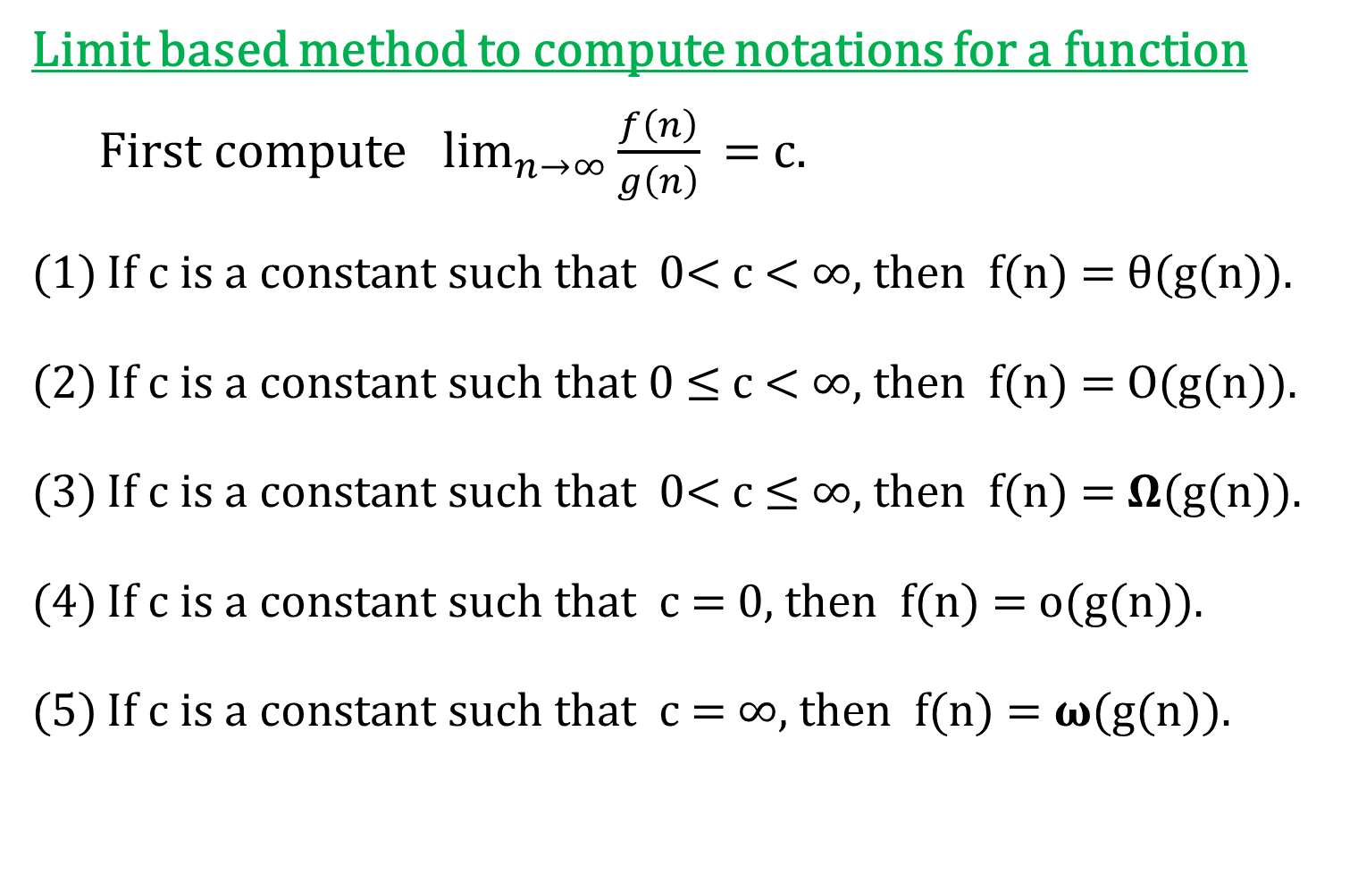
Asymptotic Notations
Limit based method to compute notations for a function
  First compute $\lim_{n→∞}{\frac{f\left(n\right)}{g\left(n\right)}}$ = c.
If c is a constant such that 0< c < ∞, then f(n) = θ(g(n)).
If c is a constant such that 0 ≤ c < ∞, then f(n) = O(g(n)).
If c is a constant such that 0< c ≤ ∞, then f(n) = 𝛀(g(n)).
If c is a constant such that c = 0, then f(n) = o(g(n)).
If c is a constant such that c = ∞, then f(n) = 𝛚(g(n)).

Slide 48
Asymptotic Notations
Exercises
1. Let f(n) and g(n) be asymptotically non-negative functions. Using the basic definition of ‚θ-notation, prove that max(f(n), g(n)) = θ(f(n)+g(n)).
2. Show that for any real constants a and b, where b > 0,
(n+a)^{b} = θ(n^{b})
3. Solve the followings:-
(a) Is 2^{n+1} = O(2^{n}) ?
(b) Is 2^{2n} = O(2^{n}) ?
4. Prove that o(g(n)) ⋂ 𝛚(g(n)) is the empty set.
5. Prove that n! = 𝛚(2^{n}) and n! = o(n^{n}) .
6. Which is asymptotically larger: lg(lg*n) or lg*(lg n)?

Slide 49
Asymptotic Notations
Exercise(cont.)
7. Arrange the following in ascending order of growth or rank the following functions by order of growth.
n³, (3/2)^{n}, 2^{n}, n², log(n), 2^{2n}, loglog(n), n!, e^{n}.
8. Let f(n) and g(n) be two asymptotically positive functions. Prove or disprove the following:-
f(n) = O(g(n)) implies g(n) = O(f(n)).
f(n) + g(n) = θ(min(f(n),g(n))).
f(n) = O(g(n)) implies lg(f(n)) = O(lg(g(n))), where lg(g(n)) ≥1 and f(n) ≥ 1 for all sufficiently large n.
f(n) = O(g(n)) implies 2^{f(n)} = O(2^{g(n)}).
f(n) = O(((f(n))²)

Slide 50
Asymptotic Notations
AKTU questions
Take the following list of functions and arrange them in ascending order of growth rate. That is, if function g(n) immediately follows function f(n) in your list, then it should be the case that f(n) is O(g(n)). f1(n) = n2.5, f2(n) = √2n, f3(n) = n + 10, f4(n) = 10n, f5(n) = 100n, and f6(n) = n2 log n
Rank the following by growth rate: n, 2lg √n, log n, log (logn), log2n, (lgn)lgn, 4, (3/2)n, n!

Slide 51
Recurrence relation
Recurrence equations will be of the following form:-
  T(n) = aT(n/b) + f(n)
  T(n) = T(n-1) + n
  T(n) = T(n/3) + T(2n/3) + n
  T(n) = T(n-1) + T(n-2)
Some approaches to sole recurrence relations
Iterative method
Substitution method
Recurrence Tree
Master theorem method

Slide 52
Substitution method
The substitution method for solving recurrences comprises two steps:
1. Guess the form of the solution.
2. Use mathematical induction to find the constants and show that the solution works.
Example: Find the upper bound of following recurrence relation T(n) = 2T(⌊n/2⌋) + n. ………..(1)
Solution: We will solve this using substitution method.
Guess the upper bound of this equation is T(n) = O(nlogn).
Now, we have to prove that this guessing solution is correct.
By definition of upper bound,
T(n) ≤ c nlogn, ∀ n ≥ n₀. ……………(2)

Slide 53
Substitution method
We will prove inequality (2) using induction method.
Assume T(1) = 1.
Using equation (1),
T(2) = 2T(⌊2/2⌋) + 2 = 2T(1) + 2 = 4
      T(3) = 2T(⌊3/2⌋) + 3 = 2T(1) + 3 = 5
For n=1.
T(1) ≤ c 1log1 ⇒ 1 ≤ c . 0 ⇒ 1 ≤ 0 (False)
Therefore, equation (2) is false for n = 1.
For n=2.
T(2) ≤ c 2log2 ⇒ 4 ≤ c . 2 ⇒ 4 ≤ 2c (True for c ≥ 2)
Therefore, equation (2) is true for n = 2.
For n=3.
T(3) ≤ c 3log3 ⇒ 5 ≤ 3c.log3 (True for c ≥ 2)
Therefore, equation (2) is true for n = 3.

Slide 54
Substitution method
Assume equation (2) is true for n= n/2. We will prove for n.
Since equation (2) is true for n = n/2, therefore
T(n/2) ≤ c (n/2)log(n/2), ∀ n ≥ n₀ ………(3)
Now for n,
T(n) = 2T(⌊n/2⌋) + n
≤ 2c (⌊n/2⌋)log(⌊n/2⌋) + n
≤ 2c (n/2)log(n/2) + n
= cn (log n – log 2) + n
= cn (log n – 1) + n
= cnlogn – cn + n
≤ cnlogn if c ≥ 1
Therefore, T(n) ≤ cnlogn if c ≥ 1.
Hence, equation (2) is also proved for n. Therefore, guessing solution is correct.
Therefore the upper bound of given recurrence relation is
T(n) = O(nlogn).

Slide 55
Substitution method
Example: Find the upper bound of following recurrence relation T(n) = 2T(⌊n/2⌋ + 17) + n
Solution: When n is large, the difference between ⌊n/2⌋ and
⌊n/2⌋ + 17 is not that large. Therefore, given equation is equivalent to the following equation
T(n) = 2T(⌊n/2⌋) + n
Similarly, since ⌊n/2⌋ and n/2 are approximately same, therefore above equation is equivalent to the following equation
T(n) = 2T(n/2) + n
Since this equation is equivalent to the previous question therefore upper bound will be T(n) = O(nlogn).

Slide 56
Substitution method
Example: Solve the following recurrence relation
T(n) = 2T(⌊√n⌋ ) + lg n
Solution: Here we change the variable n to m.
Let n = 2^{m}
Put n = 2^{m} in given equation, we get
T(2^{m}) = 2T(⌊√2^{m}⌋ ) + m
= 2T(⌊2^{m/2}⌋ ) + m
Let T(2m) = S(m), therefore
S(m) = 2 S(⌊m/2⌋ ) + m
Since this equation is equialent to the first question, therefore its solution will be S(m) = mlog(m).
Hence T(n) = T(2m) = S(m) = mlog(m) = log(n) loglog(n)
i.e. T(n) = log(n) loglog(n)

Slide 57
Substitution method
Example: Solve the following recurrence relation
T(n) = T(⌊n/2⌋ ) + T(⌈ n/2 ⌉ ) + 1
Solution: Since ⌊n/2⌋ and ⌈ n/2 ⌉ are approximately equal to n/2, therefore given equation is equivalent to following equation
T(n) = T(n/2) + T(n/2) + 1
T(n) = 2T(n/2) + 1
Now, we guess the solution is T(n) = O(n). Therefore, we have to prove T(n) ≤ cn-d, ∀ n ≥ n₀. ……………(2)
Assume this is true for n = n/2, therefore
T(n/2) ≤ cn/2 - d …………..(3)
Now for n,
T(n) = 2T(n/2) + 1
≤ 2 (cn/2 –d) + 1 (using equation (3))
= cn -2d + 1
≤ cn-d if d ≥ 1
Hence T(n) ≤ cn-d for d ≥ 1. Therefore T(n) = O(n).

Slide 58
Recurrence tree method
In a recursion tree, each node represents the cost of a single sub-problem somewhere in the set of recursive function invocations. We sum the costs within each level of the tree to obtain a set of per-level costs, and then we sum all the per-level costs to determine the total cost of all levels of the recursion.
A recursion tree is best used to generate a good guess, which you can then verify by the substitution method.

Slide 59
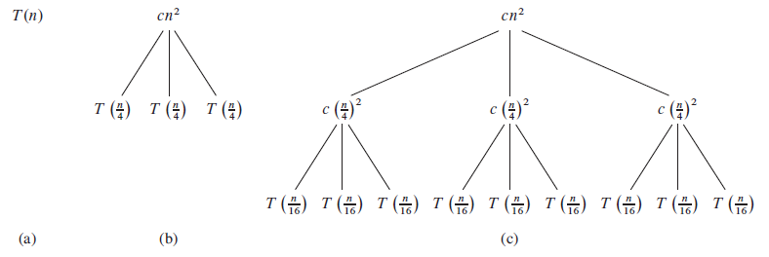
Recurrence tree method
Example: Solve the following recurrence equation
T(n) = 3T(⌊n/4⌋) + θ(n²)
Solution: This equation is equivalent to the following equation T(n) = 3T(n/4) + cn²
Here, we create recurrence tree for above equation.

Slide 60
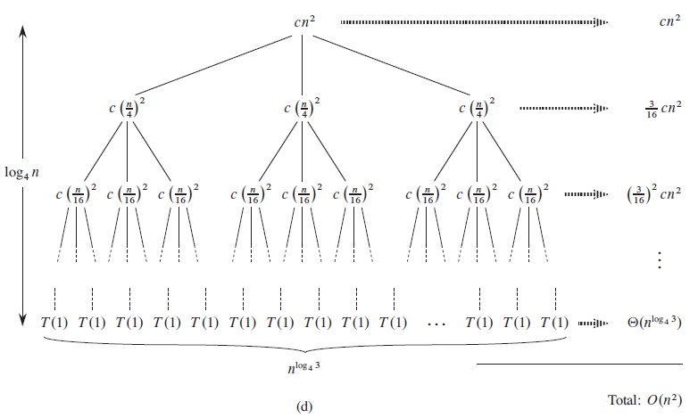
Recurrence tree method

Slide 61
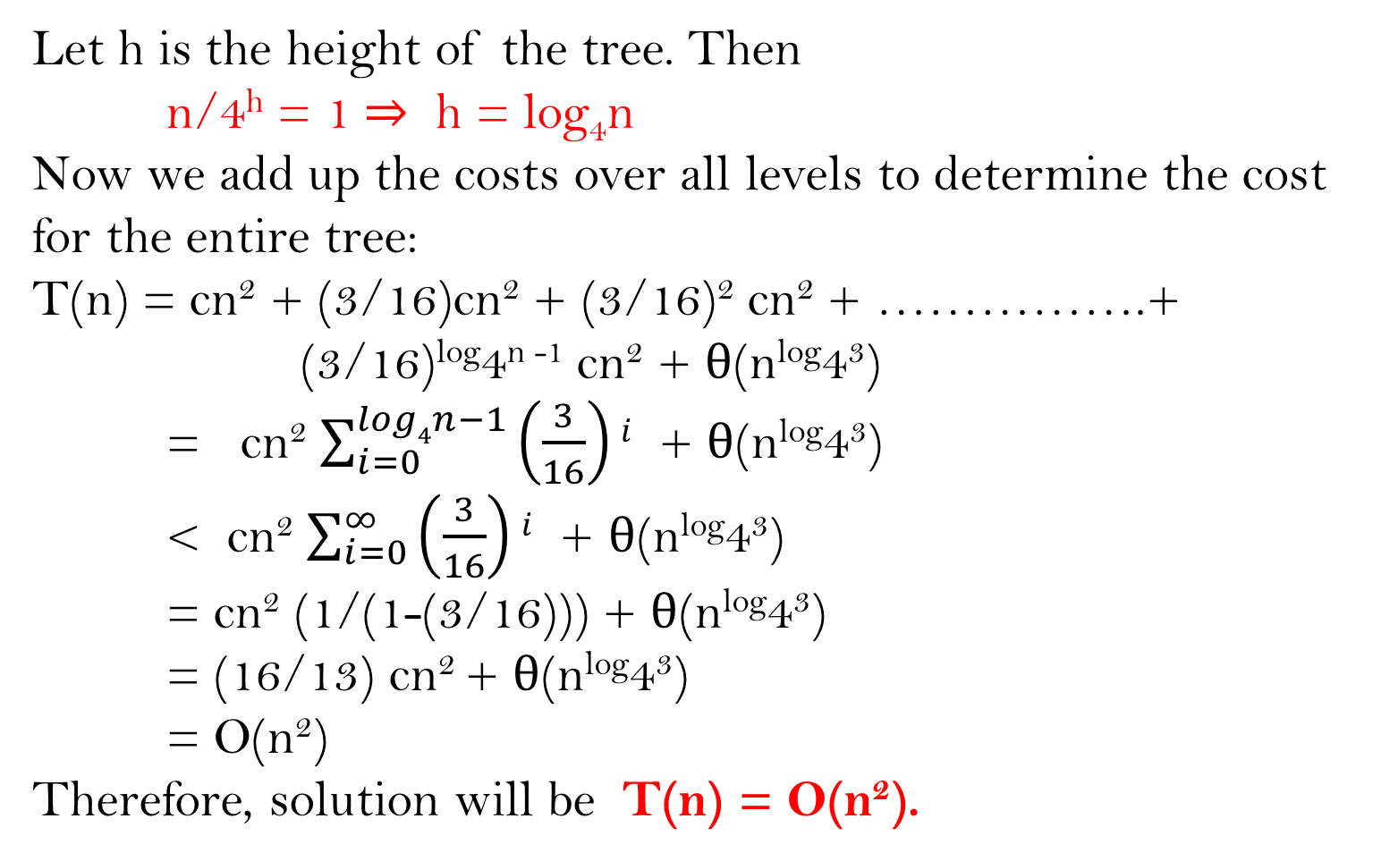
Recurrence tree method
Let h is the height of the tree. Then
n/4^{h} = 1 ⇒ h = log₄n
Now we add up the costs over all levels to determine the cost for the entire tree:
T(n) = cn² + (3/16)cn² + (3/16)² cn² + …………….+ (3/16)^{log}4^{n -1} cn² + θ(n^{log}4³)
= cn² $\sum_{i=0}^{log4n−1}{\left(\frac{3}{16}\right)i}$ + θ(n^{log}4³)
< cn² $\sum_{i=0}^{∞}{\left(\frac{3}{16}\right)i}$ + θ(n^{log}4³)
= cn² (1/(1-(3/16))) + θ(n^{log}4³)
= (16/13) cn² + θ(n^{log}4³)
= O(n²)
Therefore, solution will be T(n) = O(n²).

Slide 62
Recurrence tree method
Example: Solve the following recurrence equation
T(n) = T(n/3) + T(2n/3) + O(n)
Solution: This equation is equivalent to the following equation T(n) = T(n/3) + T(2n/3) + cn
Recurrence tree for this equation will be the following:-
cn cn
T(n)
(a)
cn/3
2cn/3
T(n/3)
T(2n/3)
(b)
T(n/9)
T(2n/9)
T(2n/9)
T(4n/9)
(c)

Slide 63
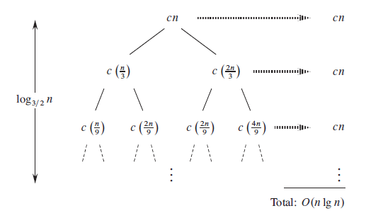
Recurrence tree method
(d)

Slide 64
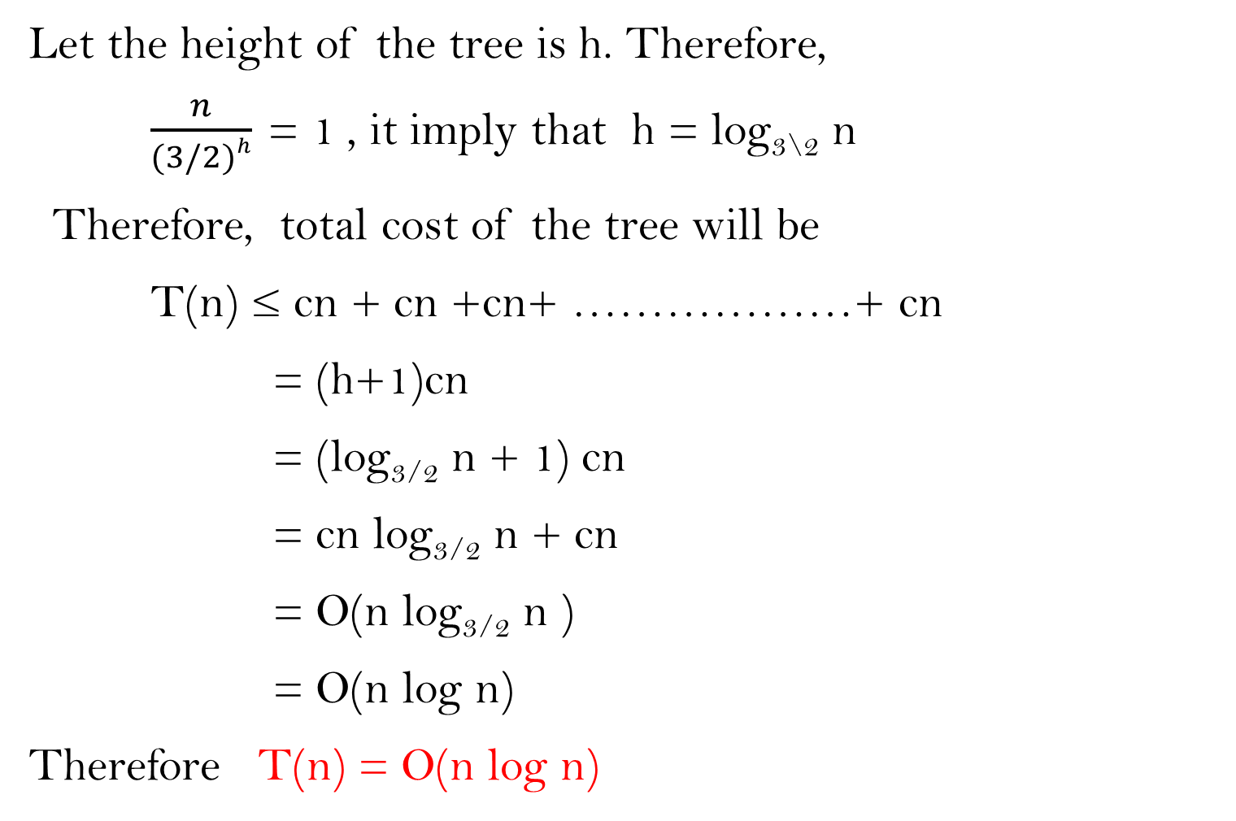
Recurrence tree method
Let the height of the tree is h. Therefore,
$\frac{n}{(3/2)h}$ = 1 , it imply that h = log_{3\2} n
Therefore, total cost of the tree will be
T(n) ≤ cn + cn +cn+ ………………+ cn
= (h+1)cn
= (log_{3/2} n + 1) cn
= cn log_{3/2} n + cn
= O(n log_{3/2} n )
= O(n log n)
Therefore T(n) = O(n log n)
(h+1)-times

Slide 65
Recurrence tree method
Exercise
(1) Draw the recursion tree for T(n) = 4 T(⌊n/2⌋) + cn, where c is a constant and provide a tight asymptotic bound on its solution. Verify your bound by the substitution method.
(2) Use a recursion tree to give an asymptotically tight solution to the recurrence T(n) = T(n-a) + T(a) + cn, where a ≥ 1 and c > 0 are constants.
(3) Use a recursion tree to give an asymptotically tight solution to the recurrence T(n) = T(αn) + T((1- α)n) + cn, where α is a constant in the range 0 < α < 1 and c > 0 is also a constant.
and c > 0 is also a constant.

Slide 66
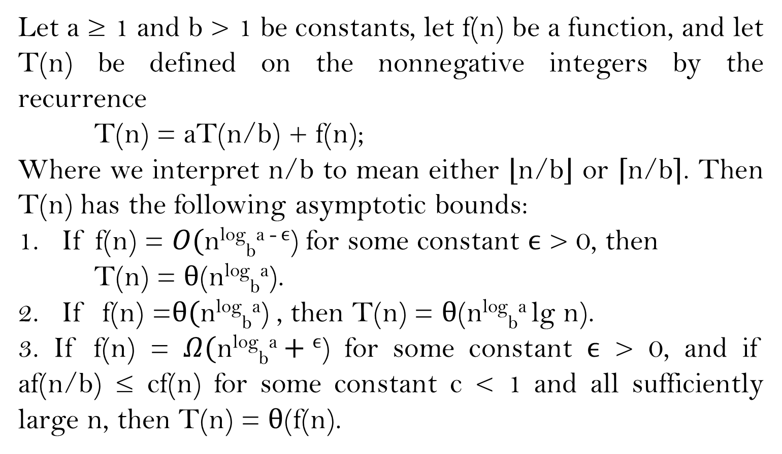
Master theorem
Let a ≥ 1 and b > 1 be constants, let f(n) be a function, and let T(n) be defined on the nonnegative integers by the recurrence
T(n) = aT(n/b) + f(n);
Where we interpret n/b to mean either ⌊n/b⌋ or ⌈n/b⌉. Then T(n) has the following asymptotic bounds:
1. If f(n) = $O(\text{n}\text{log}\text{b}\text{a} \text{-} ϵ\text{)}$ for some constant $ϵ$ > 0, then
T(n) = θ(n^{log}_{b}ª).
2. If f(n) =θ$(\text{n}\text{log}\text{b}\text{a}\text{)}$ , then T(n) = θ(n^{log}_{b}ª lg n).
3. If f(n) = $Ω(\text{n}\text{log}\text{b}\text{a}+ϵ\text{)}$ for some constant $ϵ$ > 0, and if af(n/b) ≤ cf(n) for some constant c < 1 and all sufficiently large n, then T(n) = θ(f(n).

Slide 67
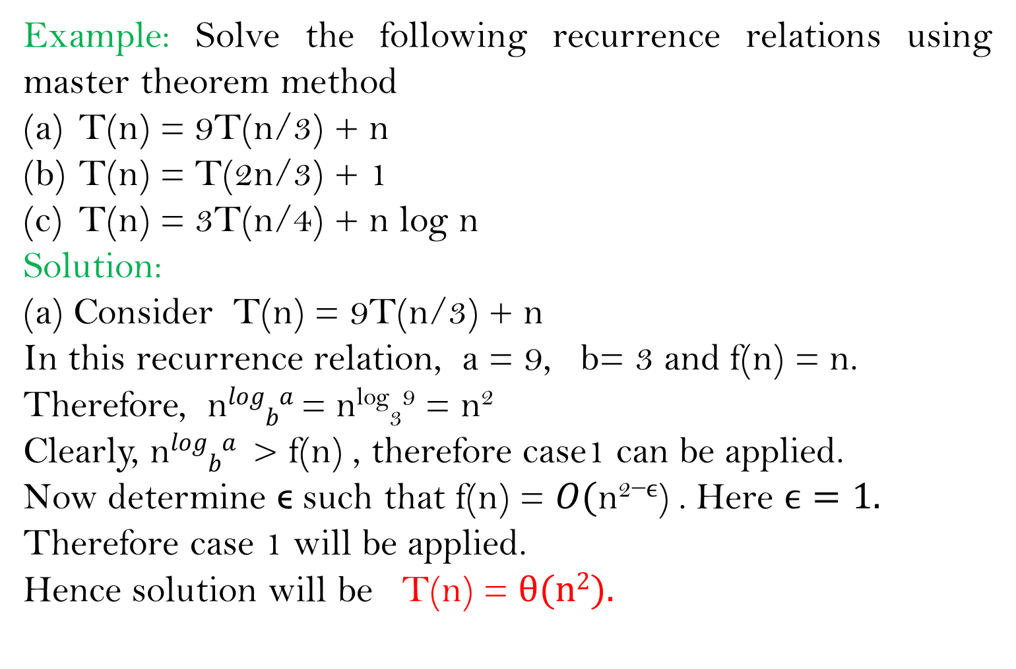
Master theorem
Example: Solve the following recurrence relations using master theorem method
T(n) = 9T(n/3) + n
T(n) = T(2n/3) + 1
T(n) = 3T(n/4) + n log n
Solution:
(a) Consider T(n) = 9T(n/3) + n
In this recurrence relation, a = 9, b= 3 and f(n) = n.
Therefore, n$logba$ = n^{log}₃⁹ = n²
Clearly, n$logba$ > f(n) , therefore case1 can be applied.
Now determine ϵ such that f(n) = $O(\text{n}\text{2}\text{−}ϵ\text{)}$ . Here $ϵ=1.$
Therefore case 1 will be applied.
Hence solution will be T(n) = θ(n²).

Slide 68
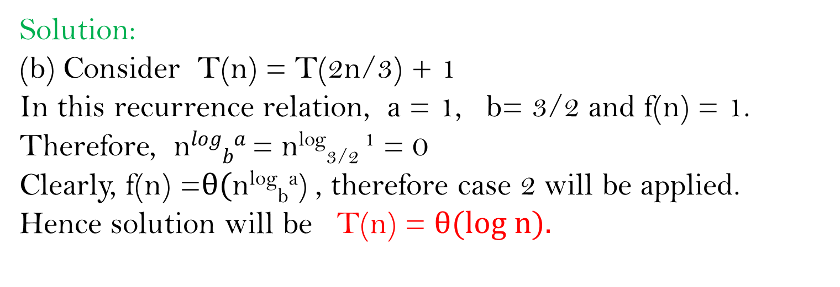
Master theorem
Solution:
(b) Consider T(n) = T(2n/3) + 1
In this recurrence relation, a = 1, b= 3/2 and f(n) = 1.
Therefore, n$logba$ = n^{log}_{3/2} ¹ = 0
Clearly, f(n) =θ$(\text{n}\text{log}\text{b}\text{a}\text{)}$ , therefore case 2 will be applied.
Hence solution will be T(n) = θ(log n).

Slide 69
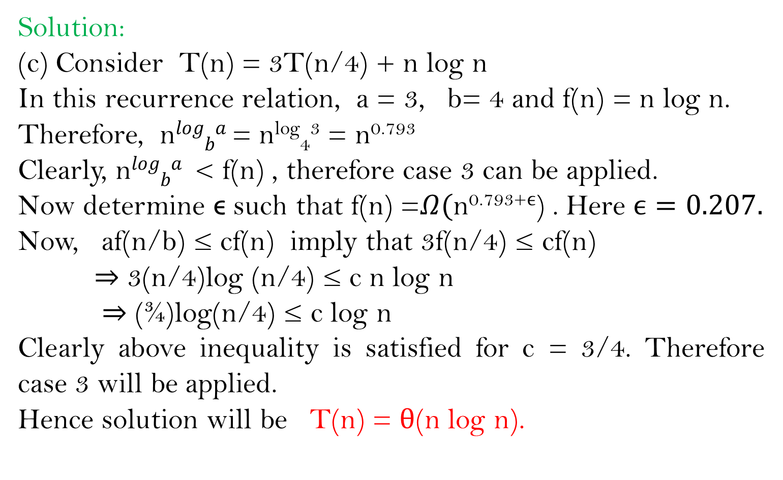
Master theorem
Solution:
(c) Consider T(n) = 3T(n/4) + n log n
In this recurrence relation, a = 3, b= 4 and f(n) = n log n.
Therefore, n$logba$ = n^{log}₄³ = n^{0.793}
Clearly, n$logba$ < f(n) , therefore case 3 can be applied.
Now determine ϵ such that f(n) =$Ω(\text{n}\text{0.793+}ϵ\text{)}$ . Here $ϵ=0.207.$
Now, af(n/b) ≤ cf(n) imply that 3f(n/4) ≤ cf(n)
⇒ 3(n/4)log (n/4) ≤ c n log n
⇒ (¾)log(n/4) ≤ c log n
Clearly above inequality is satisfied for c = 3/4. Therefore case 3 will be applied.
Hence solution will be T(n) = θ(n log n).

Slide 70
Master theorem
Example: Solve the following recurrence relation
T(n) = 2T(n/2) +n log n

